Slide 1
IAS 2018
July 25, 2018

Slide 2
In theory, all patients receive regular CD4 and viral load testing which are used to manage their care over time. In reality…?

Slide 3
HIV diagnostics are at a crossroads
Since 2015:
“Treat All”
90-90-90 campaign and massive scale up of viral load testing
ART with higher resistance barriers (TLD) introduced in first line
Promise of the “Undetectable = Untransmittable” campaign
Flattening of the resource envelope
Reality:
As little as 50% of CD4 and VL test results are actually used for patient management
The resource envelope is more stretched than ever
Notes:
The scale up of “Treat All”, differentiated service delivery and the potential introduction of antiretroviral regimens with higher resistance barriers (eg, TLD)—all in the setting of limited resources-- has challenged existing paradigms of diagnostic testing for HIV care.

Slide 4
What is future of CD4 and VL?
The promise and history of CD4 use and scale up for patient management and surveillance
The promise and history of viral load use and scale up for patient management and surveillance
The reality: Utilization of VL test results to change practice in Malawi
Debate on the future of CD4 and VL scale and use
Community response
Panel discussion

Slide 5
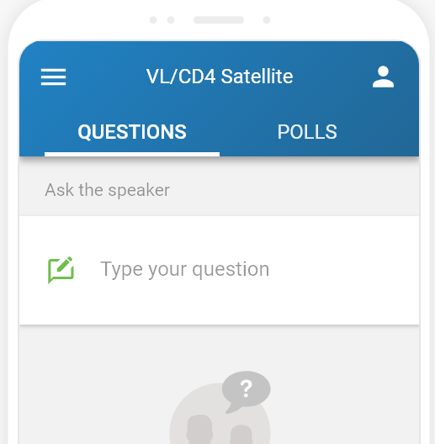
Instructions for the audience
Open a browser on any laptop, tablet or smartphone
Go to slido.com
Enter the event code #VLCD4
Throughout session, type in your questions or endorse others’ questions.
The panel will answer the most “popular” questions.

